Slide 1
Introduction to Risk Analysis Verbal Language of Risk Analysis and Definitions
Unit 1
Risk Analysis in Safety Engineering
Spring 2022

Slide 2
References
Modarres, M., Risk Analysis in Engineering, Taylor&Francis, 2006, Chapter 1 (Modarres, RAE)
Norman Fenton and Martin Neil, “Risk Assessment and Decision Analysis with Bayesian Networks, 2nd ed” CRC Press, 2019, Chapter 1 (RDBN, 2019)
Pasman, Hans J., Risk Analysis and Control for Industrial Processes-Gas, Oil and Chemicals: A System Perspective for Assessing and Avoiding Low-Probability, High-Consequence Events, Elsevier, 2015
Fischhoff, Baruch and J. Kad vany, Risk, A Very Short Introduction, Oxford, 2011 (Fishhoff, 2011)
Modarres, M., M. Kaminskiy, V. Krivtsov, Reliability Engineering and Risk Analysis, 2nd ed, Taylor & Francis, 2010 (Modarres, RERA)
Jordaan, Ian, Decisions Under Uncertainty– Probabilistic Analysis for Engineering Decisions, Cambridge University Press, 2005 (Jordaan, 2005)
Lowrance, W.W., Of Acceptable Risk, William Kaufmann, Los Altos, CA, 1976 (Lowrance, OAR)
Shortreed, J., K. Dinnie, and D. Belgue, “Risk criteria for public policy.” Proc First Biennial Conf on Process Safety and Loss Management, Edmonton, Alberta, Canada, 1995 (Shortreed, et al, 1995)
Aven, Terje, Quantitative Risk Assessment, The Scientific Platform, Cambridge, 2011 (Aven, 2011)
Lyse, Quantitative Risk Analysis, Lyse LNG base load plant Train 1, Linde, R100-LE-S-RS0003, 25.08.2007 (Lyse, 2008)

Slide 3
What is Risk?
The New World Dictionary defines risk as the chance of injury, damage, or loss.
To put oneself "at risk" means to participate voluntarily or be involuntarily involved in an activity that could lead to injury, damages, or other losses.
This definition of risk does not explicitly state the likelihood or chances of gain and success, which we can achieve by accepting levels of risk, such as monetary risk
Our preference is always that risk for gain be as low as feasible or As Low As Reasonably Practicable (ALARP), as practiced in Industry.

Slide 4
Risk Acceptance Variables
Which of these two types of activities (Voluntary or Involuntary), are people more willing to tolerate to a higher level? Why?
What are the two most sensitive variables that influence the level or range of Acceptable Risk?
1. Perceived Benefits and
2. Perceived level of Control

Slide 5
Basic Definitions
Hazard: inherent potential to cause damage to people, equipment, environment, or to what we value.
How to measure hazard characteristics, magnitude?
Hazard of Toxic Gas, Measured by toxicity, concentration
Hazard of Fire, Measured by size, propagation rate
Risk: represented by a measure of potential loss or gain with losses resulting from hazards in natural events or human activities.
How to measure risk?
Consequences or Severity of occurrence
Likelihood of occurrence
In its simplest form:
RISK = Frequency X Consequence
Notes:
of occurrenceHazard: fire
Risk: valued item consumed

Slide 6
Basic Definitions
Risk Analysis: process of assessing, managing, decision making, and informing others about existence, nature, magnitude, probability, contributing factors, and uncertainties of potential losses (or gains).
Risk level: size or magnitude range due to hazard exposure: Estimates of both the probability (or frequency) of upset scenarios and outcome consequences
Scenario: sequence of specific events beginning with an initiation event, intermediate events, and terminating in an outcome event. Various inter-related events can influence a scenario.
Notes:
Include valued item consumed by fire
Include also probability of this loss event

Slide 7
Why measure hazards and risks?
To manage and predict something optimally, we must model it.
It is easier to spot trouble and take measures proactively
Easier for decision making

Slide 8

Probability or Frequency
Probability or likelihood - A quantitative measure of the uncertainty in the occurrence of a value, value range, event, or an event sequence.
Probability (Pr) is defined as a unitless number within [0,1].
Frequency - Number of occurrences of an event per unit time, often hour or year, or per distance, area, or volume.
Frequency of occurrence is used to estimate probability of occurrence.
In its simplest form,
Relative Frequency= Point value of Probability of Occurrence =
[(# of specific events, n)/(# of all events, N)

Slide 9
Consequences
The various outcomes of taking risk (losses/gain)
Fatalities, monetary losses, property damage
Financial gain

Slide 10
Hazards
Which tool when used presents the greatest hazard to user? Why?
10

Slide 11
Risks
Which tool when used presents the Highest risk to user? Why?
11

Slide 12
Risk in Life
Everything that we do incurs risk over a ‘range’, because of uncertainties of gain or loss in the outcomes of our activities or in the likelihood of individual outcomes
Think of an example: driving to a job interview to Houston
Risk of an activity can be reduced to zero only by eliminating the activity
Don’t drive at all!!
Or, risk can be managed within tolerable ranges by identifying and managing the variables:
Variables: Vehicle maintenance, Traffic, Weather etc.

Slide 13
Risk Levels
You can reduce risk, but that will incur costs
Risk Assessment and Risk Management is an approach to achieve a balance between cost and rewards
A risk level that is acceptable or tolerable to one person, organization, or community, may not be acceptable to another person, organization, or community.
Why?

Slide 14
Getting to Know One Another
Have you conducted a risk assessment?
Today
This week
This month
This year
Have you done any of the following?
Driven a car at very high speed
Crossed a busy street on foot
Flown in an airplane
Parachuted, bungee jumped, etc.

Slide 15





Risk attitude

Slide 16


Risk Perception
Because of variation of perception of risk level and benefits (willingness to accept risk)

Slide 17

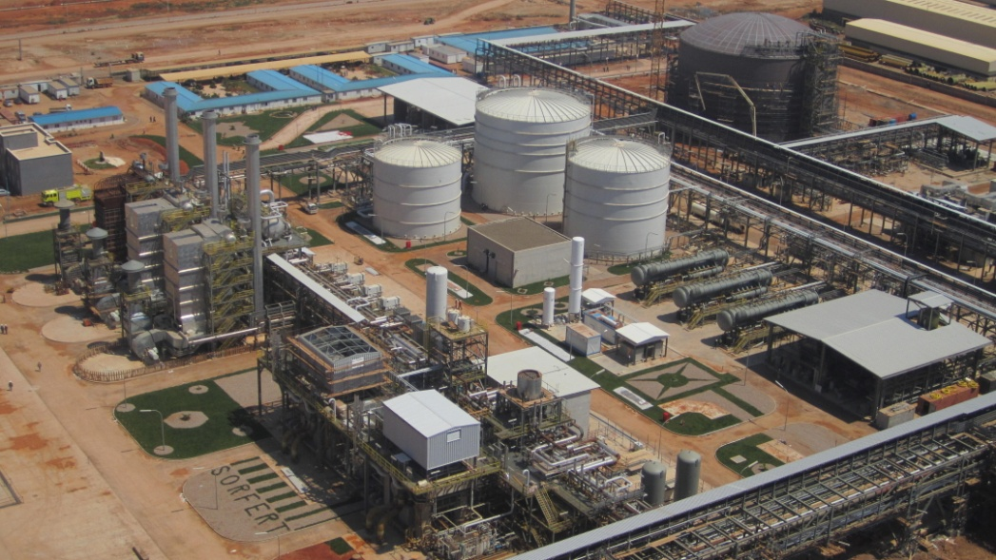

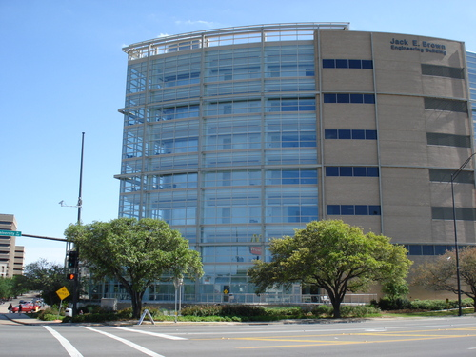
Where are you safest?

Slide 18
Getting to Know One Another
Raise your hand if you do crazy stuff regularly
You are risk takers (RT people)
Stand if you do never do crazy stuff
You are risk averse (RA people)
Stand if you do crazy stuff sometimes
You are risk neutral (RN people)
What profile do most companies adopt?

Slide 19
Basic Definitions Hazard / Risk / Safety
HAZARD: A chemical or physical condition that has the potential for causing damage to a risk receptor (people, property or the environment).
An attribute or property of a material
RISK: Measure of damage due to a hazard taking into account both the likelihood and magnitude of damage (consequence).
SAFETY: Judgment of the acceptability of risks posed by hazards. (Something is Safe if its Risks are judged acceptable).
RISK ACCEPTABILITY: Determined by criteria established by company or industry or established for the operation based on the ALARP principle.
There are degrees of risk and hence degrees of safety.

Slide 20
Risk Management Components (the five questions of all robust risk assessments)
What can go wrong?
Hazard Identification
What are the adverse impacts or consequences ?
Consequence analysis
How likely is it to happen?
Frequency Analysis
Do I need to do anything about it?
Risk Evaluation / Risk Assessment
What should I do about it?
Risk Control
If you planning a job in an operating plant – what other question?
Risk Analysis (qualitative or quantitative)

Slide 21
Risk Tolerance
Industrial risks are now less acceptable to industrial employees, company stakeholders, and to the public than they were previously
A generally acceptable guideline for acceptable voluntary risk is that industrial employees should be exposed to no more risk on the (voluntary) professional work job than they are exposed to involuntary activities outside of work.

Slide 22
Risk Tolerance is Lessening
The public expects minimal risk and some people, including legislators, may even demand “zero risk”
Decision Models: Models for making optimum decisions.
Managers need to establish decision models to justify to stakeholders and to the public:
Decisions must be based on all available relevant information and more information should be sought to lower uncertainty.
The quality of a decision model should not be judged by the single occurrence of an uncertain outcome but instead by track records of multiple decisions and subsequent outcomes compared to what was predicted

Slide 23
Risk Tolerance or Acceptability Levels
Risk tolerability ranges today are based on events in human life:
An involuntary risk (fatality risk) is generally considered tolerably low by the public if it is similar to or lower than the risk of fatality per person-year due to natural hazards
Historically ~10⁻⁶ per year.
A voluntary risk is unacceptably high to the public if it is near to or above the risk of fatality per person due to disease
Historically ~10⁻³ per year.
Risk acceptance criteria for events that could lead to fatalities were founded on the range between the two frequency values: [10⁻⁶, 10⁻³]
(Shortreed, et al, 1995)

Slide 24
Traditional Measures of Risk Acceptability
Regulations (such as for toxic exposures, e.g., OSHA, EPA)
Industry sector practice
Company practice
Engineering judgment, expert judgment based on experience
Risk communication
OSHA: Occupational Safety & Health Administration
EPA: Environmental Protection Agency

Slide 25
Importance of Risk Analysis (RA)
Managers must reduce risk and manage remaining risk to retain their rights to operate
Applications of risk analysis lies in design, manufacturing, operation, maintenance, policy, and regulatory decisions for a Socio-Technical System (STS) involving everyone (from frontline operators to government leaders)

Slide 26
Areas of Risk Applications
Category | To Estimate
Health | Disease and loss of life
Safety | Harm due to natural events, fabricated products, technologies, systems
Security | Harm due to war, terrorism, cyberattack, riot, crime, misinformation
Financial Legal | Individual, institutional, and societal monetary losses and gains Probability of innocence or guilt beyond reasonable doubt.
Environmental | Losses due to noise, contamination, and pollution in ecosystems

Slide 27
Engineering Risk Analysis Methods and Critical Role of Decisions Under Uncertainty During System Life Cycle
Conceptual design | Decisions about alternative design options
Design | Decisions to help prevent, reduce or eliminate hazards (inherently safer design), minimize life-cycle cost, maximize performance
Development | Identify & test systems that contribute most to risk, quality assurance, warranty development
Regulation (Risk Management) | Decisions concerning system elements that contribute most to risk, set monitoring and performance criteria, perform inspections
Operation (Risk Management) | Decisions to optimize cost of operation, tests, and maintenance, define surveillance requirements, schedules, replacement policies & decisions, aging estimation & management, security measures
Decommissioning | Decisions for safe decommissioning alternatives, select disposal methods, assess long term liability

Slide 28
Application of RA under Uncertainty: Managing Reliability of a New Product
Success of new products often depends on their Reliability as experienced by end users. Too many faults in the delivered product can lead to financial disaster for the producing company or a failed military mission, including loss of life. Therefore, pre-release testing of new systems is critical. (Recall the insufficiently tested Boeing 737 MAX: 2 failures, 346 deaths!)
However, testing requires time. A tested system delivered after competitors have entered the market may not succeed. So how do you decide when a system is ‘good enough’ for release, or how much testing is needed?
You may have hard data from test results, but subjective information about the quality of testing and validation of the test environment also must be included in RA and Decision Making. All relevant information and uncertainties are combined for evaluation and decisions.

Slide 29
Risk Analysis Approaches
Traditional Risk Analysis
Manage technical systems, considered accidents due to operator error and equipment error,
Decisions based on point value alone
Assumed independence of components.
Easy to do, but not effective
Systems Approach to Risk Analysis:
Manages Socio-Technical Systems (STS) and their organizations, accident investigated to determine underlying causes;
Decisions based on ranges and distributions of information
Considered significant interdependencies.
Requires more effort to learn and practice but more realistic

Slide 30
Risk Assessment Models
Models to represent engineering systems:
Deterministic models: predict nearly exact or unique result, e.g., what caused a component or system to fail?
Can we do this? Not really since we do not always know the mechanisms of occurrence (lots of uncertainty!)
Probabilistic models: using uncertainty data and information, predict output ranges to estimate uncertain events that could result in losses.
Uncertainties due to ranges of critical variables must be included in models to estimate probability of outcome events.

Slide 31
Types of Risk Assessment
Quantitative RA: calculate risk in form of a numerical probability (or frequency) distribution of an event and the event consequence magnitude distribution. Data-centric, model-based.
Semi-Quantitative RA: use scores or order of magnitude for frequency and outcome
Qualitative RA: use of linguistic or ordinal scales (e.g., low, medium, high) for probability or the outcome magnitude. Often used for screening, but the scales are ambiguous and are not reliable. Subjective

